Slide 1
Software Engineering

Slide 2
COURSE INFORMATION
Instructor: Israr Ahmad
  Faculty of Computer Science and Engineering
  Email: israr.ahmad@giki.edu.pk
  Office: CS-20, 3rd floor, AcB
  Office Hours: Tuesday/Thursday 01:00 PM - 4:00 PM
Prerequisite: CS112
Course material: MS Teams/LMS
Teams Code: k5x1wyl

Slide 3
Books
Textbooks:
Software Engineering (10th Ed.), By Ian Sommerville (2016). ISBN: 9780137586691
Software Engineering: A Practitioner's Approach (9th Ed.) By Roger Pressman, and Bruce Maxim (2019)
(uploaded on Teams)

Slide 4
Dishonesty, Plagiarism in Quizzes, Assignments
All individuals involved in any kind of cheating in any exam, quiz, assignment or project will get -50% score.

Slide 5
Attendance
Students are required to attend 100% classes of courses registered and can not abstain from even a single class.
For circumstances beyond their control, students must apply for leave on prescribed Leave Application form.

Slide 6
Tentative Evaluation Breakdown
Assignments, Quizzes, Project and or, Class Participation | 30
Midterm Exam | 30
Final Exam | 40
Total | 100

Slide 7
Course Execution
3 lectures of 50 minutes every week
No lab
Course contents will be available at MS Teams

Slide 8
Some Rules
There is only one rule that will make the rest of the rules
  Raise your hand before asking any question and then WAIT for the permission
  Never ever miss a class
  Never ever “sleep” in the class
  DO NOT use cell phones in the class
  Always communicate in the official communication language (i.e., Urdu/English)

Slide 9
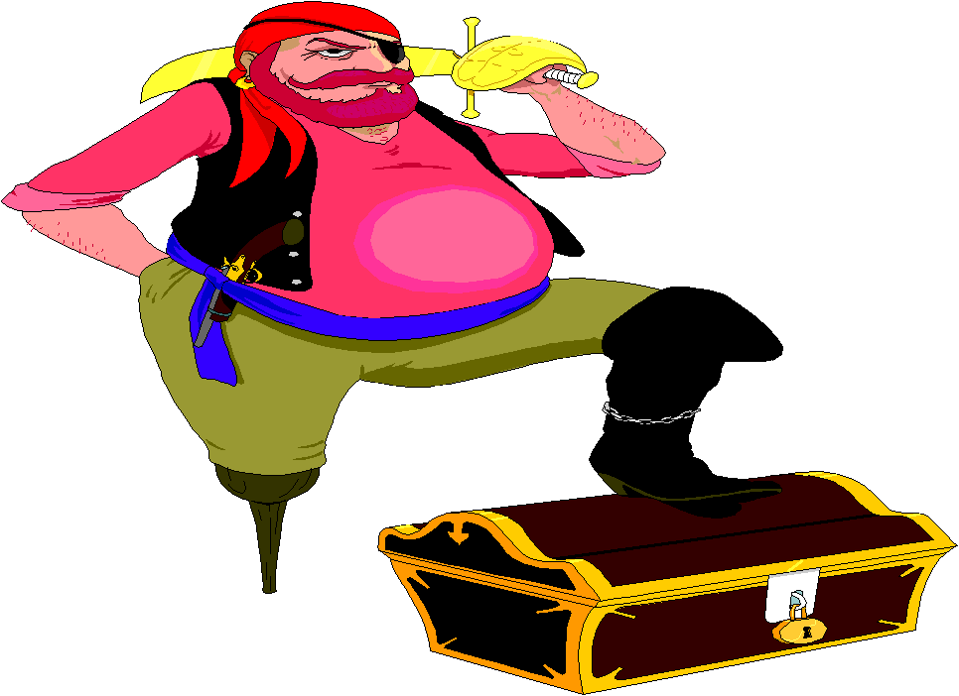
Motivation
1. What do you expect from this course?
2. What is the difference between a Programmer and a Software Engineer?

Slide 10
Software Engineer vs Programmer
Scope vs. Lifecycle:
Programmer: Focuses on a single phase: Implementation (writing code). They receive a problem and write the logic to solve it.
Software Engineer: Owns the entire Software Development Life Cycle (SDLC). They figure out what the problem actually is (Requirements), design the system (Architecture), write the code, and prove it won't break (Testing/QA).

Slide 11
Software Engineer vs Programmer
Isolation vs. Scale:
Programmer: Works in isolation. The goal is to make the code compile and run locally on their own machine.
Software Engineer: Works in a complex ecosystem. The goal is to write code that integrates seamlessly with what 50 other developers are writing, using version control (Git), and deploying to cloud servers.

Slide 12
Software Engineer vs Programmer
The Measurement of Success:
Programmer asks: "Does the code work right now?"
Software Engineer asks: "Will this code be readable, maintainable, and secure three years from now when I have left the company and someone else has to fix it?"

Slide 13
Software Engineer vs Programmer
Tools of the Trade:
Programmer tools: IDEs, compilers, stack overflow.
Software Engineer tools: Jira, Git, CI/CD pipelines, automated testing frameworks, Docker, and system architecture diagrams.

Slide 14
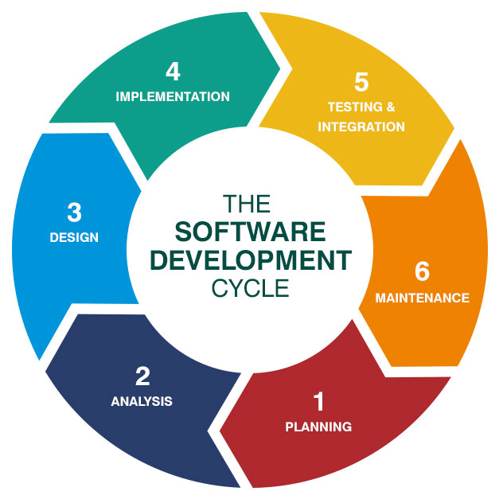
SDLC

Slide 15
Let's Begin ☺

